Slide 1
Voting Rules in Python
Generating election examples
M2 BDMA
Decision Modelling
Fall 2023
Jose Antonio Lorencio Abril

Slide 2
Election example: a candidate wins all
1st Approach
Theorem
If there are only two profiles and there is a candidate with more than 50% of the votes, then this candidate wins under all voting rules, except maybe Borda.
If the candidate with more than 50% of the votes is in second place in the other profile, then this candidate wins under Borda too.
Proof:
Plurality: The candidate with more than 50% of the votes wins.
Plurality with runoff: The candidate with more than 50% of the votes wins.
Condorcet: If there is a candidate with more than 50% of the votes, it is the Condorcet winner.

Slide 3
Election example: a candidate wins all
1st Approach
Proof:
Borda:
n voters, the top candidate has k votes, with k>n/2
The second top candidate has then n-k votes
Top candidate earns P1 = n*k+(n-1)*(n-k) points
Second top candidate earns P2 = (n-1)*k+n*(n-k)
It’s easy to reduce P1>P2 to k>n-k, which is true because k>n/2.
Using this theorem to generate an example
Generate the profile P1=a>b>c>... until having m candidates in the profile
Generate the profile P2=b>a>c>... changing the order of the first two candidates
Assign n/2+1 votes to P1
If n is even, assign n/2-1 votes to P2; if n is odd, assign n/2 votes to P2
This way, all conditions are satisfied

Slide 4
Election example: a candidate wins all
1st Approach
Result:
A>B>C>D>E>F for 21 voters
B>A>C>D>E>F for 19 voters
Winner is A.

Slide 5
Election example: a candidate wins all
2nd Approach
Random generation
The theorem approach can be boring. There are more sophisticated approaches.
For instance, we can generate elections randomly until all conditions are met.
Generate a random profile with n candidates, ordered randomly
For each voter from 1 to n:
With probability p, I generate a new random profile
With probability 1-p, I add another vote to the previous profile
Check the conditions. If they are not met, repeat

Slide 6
Election example: a candidate wins all
2nd Approach
Result:
D>C>B>E>F>A for 4 voters
B>D>C>F>E>A for 22 voters
C>B>E>A>F>D for 14 voters
Winner is B.

Slide 7
Election example: a candidate wins all
3rd Approach
Genetic Algorithm
I thought that the random approach might be too inefficient, so I tried to develop a more efficient approach through a GA.
Generate the initial population of K elections randomly
Evaluate the fitness for each election:
fitness = 3*full_win + 2*req_1 + req_2,
where
full_win = 1 if a candidate wins all, 0 otherwise
req_1 = 1 if no more than 90% of voters have the same preference, 0 otherwise
req_2 = 1 if no more than 70% of voters have the same best candidate, 0 otherwise
Repeat until there is an election with fitness == 6:
Select best elections
Crossover by roulette wheel selection
Mutation
Evaluate fitness

Slide 8
Election example: a candidate wins all
3rd Approach
Genetic Algorithm
Selection
By roulette wheel: assign higher probability to those with higher fitness
Crossover
To combine two elections, we merge the two elections in E:
For each profile in E:
new_election[profile] += 1
E[profile] -= 1
if voters(new_election) = n, break
Example:
Parent1 = {abc:2,bac:1}, Parent2 = {cab:2, bac:1}
E = {abc:2, bac:2, cab:2}
new_election = {abc:1, bac:1, cab:1}

Slide 9
Election example: a candidate wins all
3rd Approach
Genetic Algorithm
Mutation
If the election has only one profile, divide it into two
If the election has only two profiles, divide it into three
Else:
Remove the least common profile
Add its votes to the most common profile

Slide 10
Election example: a candidate wins all
3rd Approach
Result:
D>C>B>E>F>A for 4 voters
B>D>C>F>E>A for 22 voters
C>B>E>A>F>D for 14 voters
Winner is B.

Slide 11
Election example: 4 winners
In this case, I have done:
The random approach: almost the same, change the conditions to check
The GA: almost the same, change the fitness function:
fitness = 2*n_winners + req_1 + req_2,
n_winners is the amount of different winners
In this case, we finish when the fitness is 8.

Slide 12
Election example: 4 winners
Result:
D>A>E>F>B>C for 16 voters
F>B>A>E>C>D for 6 voters
F>C>E>A>D>B for 10 voters
E>C>B>A>F>D for 8 voters
Winners are:
Plurality: D Plurality Runoff: F
Condorcet: A Borda: E

Slide 13
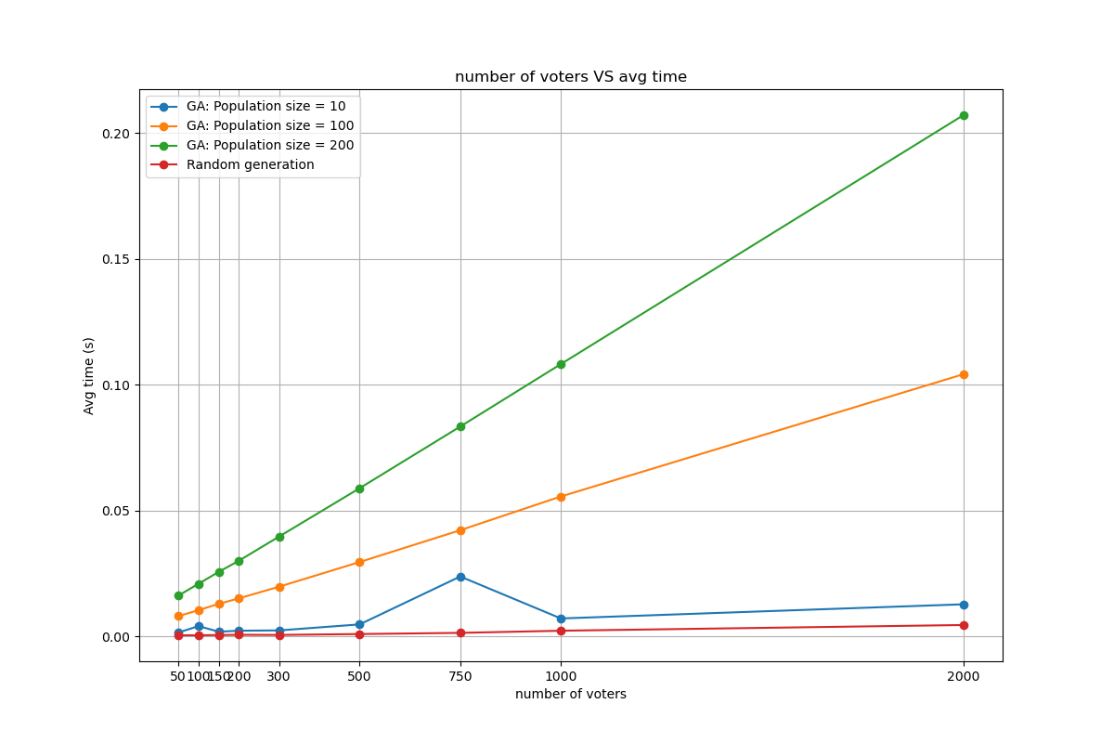
Some performance analysis

Slide 14
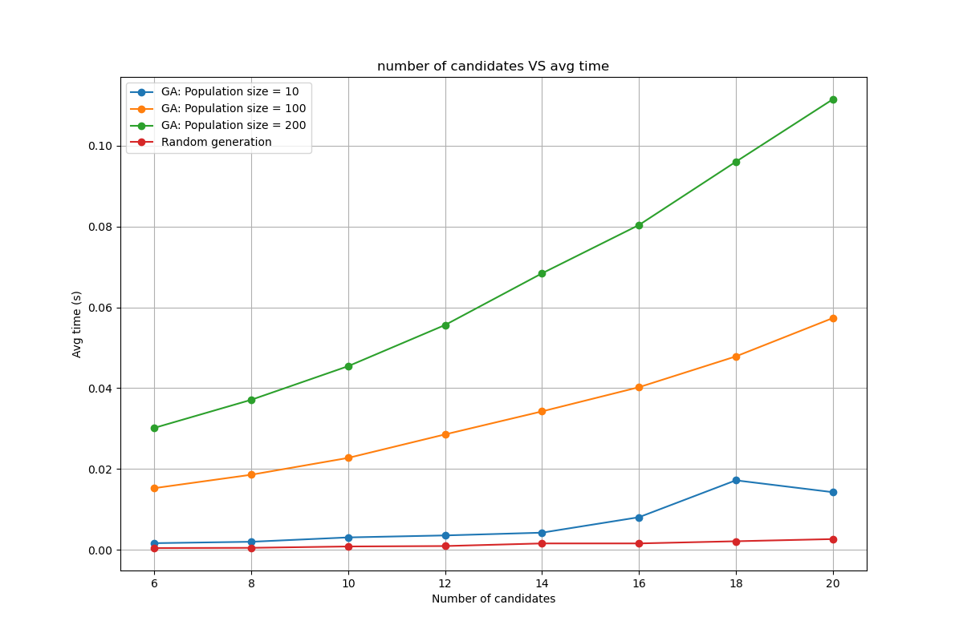
Some performance analysis

Slide 15
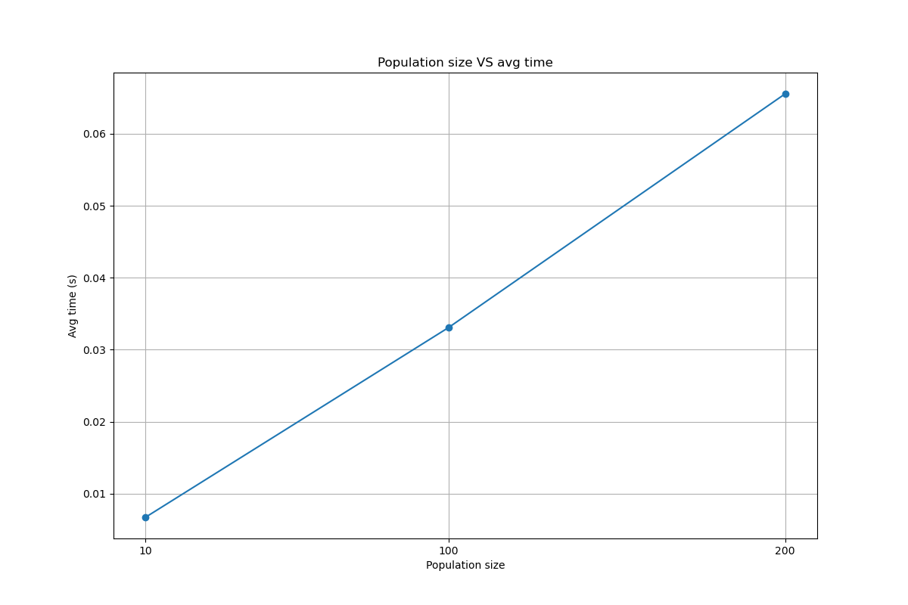
Some performance analysis

Slide 16
Some performance analysis
The results came out worse than I expected, because I believe that the totally random approach is quite likely to find a solution.
Anyways, it has been interesting to develop the GA method and maybe it can be further improved.

